Slide 1
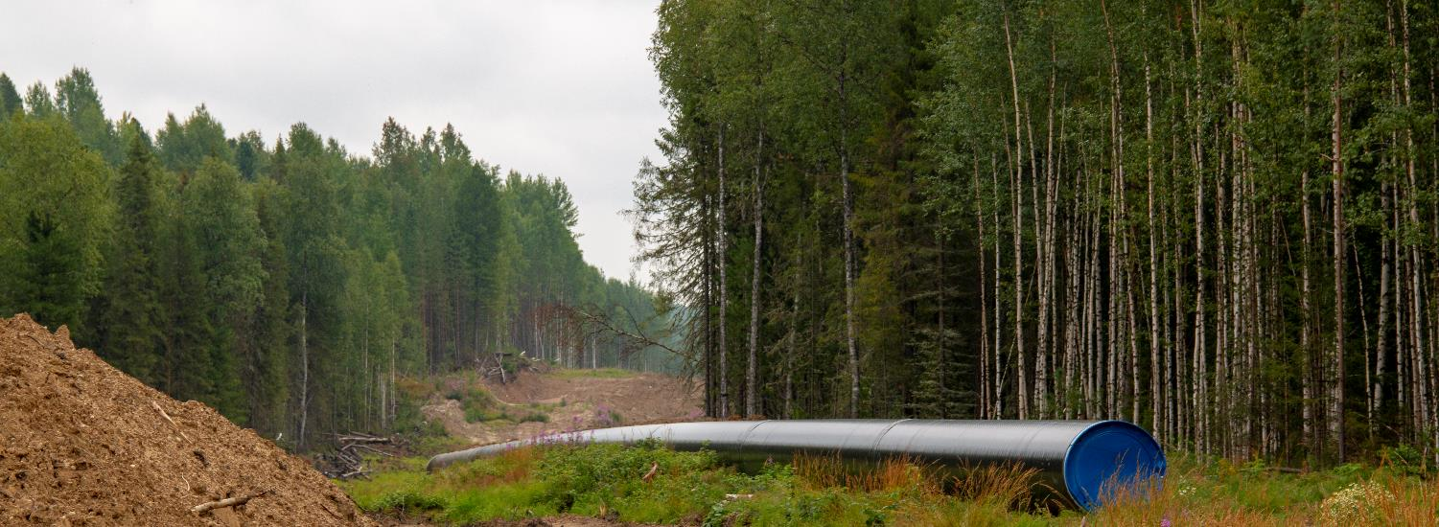
U.S. Department of Transportation
Pipeline and Hazardous Materials Safety Administration
Office of Pipeline Safety
Carbon Dioxide Pipeline Safety Public Meeting
May 31st, 2023

Slide 2
Agenda Overview
Max Kieba
Director of the Program Development Division
Office of Pipeline Safety Pipeline and Hazardous Materials Safety Administration (PHMSA)

Slide 3
Welcoming Remarks
Tristan Brown
Deputy Administrator
Office of The Administrator

Slide 4
PHMSA Pipeline Safety Oversight
Alan Mayberry
Associate Administrator
Office of Pipeline Safety Pipeline and Hazardous Materials Safety Administration (PHMSA)

Slide 5
Who Regulates What? How are Projects Reviewed?
Moderator: Max Kieba, PHMSA

Slide 6
Harold Winnie, Program Manager – Central Region Molly McEvoy, Environmental Protection Agency
Jon Wolfgram, National Association of Pipeline Safety Representatives (NAPSR)
Steve Giambrone, Louisiana State Pipeline Safety Program
Kevin Dooley, U.S. Department of Energy

Slide 7
Open Comments/Questions
Moderator: Max Kieba, PHMSA

Slide 8
Public Perspectives
Moderator: Mary McDaniel, PHMSA

Slide 9
Amanda McKay, Pipeline Safety Trust (PST)
Steven Feit, Center for International Environmental Law (CIEL) Carolyn Raffensperger, Science and Environmental Health Network
Cindy Hansen, Landowner

Slide 10
Open Comments/Questions
Moderator: Max Kieba, PHMSA

Slide 11
Tribal Government Perspectives
Moderator: Max Kieba, PHMSA

Slide 12
Arlando Teller, U.S. DOT Assistant Secretary for Tribal Government Affairs
Sikowis Nobiss, Great Plains Action Society
Travis Hallam, Three Affiliated Tribes Pipeline Authority

Slide 13
Open Comments/Questions
Moderator: Max Kieba, PHMSA

Slide 14
Current State of R&D, Standards, Design, Materials, Construction, Geohazards
Moderator: Bill Caram, PST

Slide 15
Gary Choquette, Pipeline Research Council International (PRCI)
Ben Hanna, DNV
Yong-Yi Wang, Center for Reliable Energy Systems (CRES) Mary McDaniel, PHMSA

Slide 16
Open Comments/Questions
Moderator: Max Kieba, PHMSA

Slide 17
U.S. Department of Transportation
Pipeline and Hazardous Materials Safety Administration
Office of Pipeline Safety
Carbon Dioxide Pipeline Safety Public Meeting Day 2
June 1st, 2023

Slide 18
Welcoming Remarks
Osasu Dorsey Chief Counsel
Pipeline and Hazardous Materials Safety Administration (PHMSA)

Slide 19
International Perspectives on CO2 Pipeline Safety
Moderator: Max Kieba, PHMSA

Slide 20
Iain Colquhoun, CER
Tijani (TJ) Elabor, CER
Simon Grant, UK Health and Safety Executive (HSE)

Slide 21
Open Comments/Questions
Moderator: Max Kieba, PHMSA

Slide 22
Dispersion Modeling
Moderator: Mary McDaniel, PHMSA

Slide 23
Simon Gant, UK HSE
Paul Blackburn, Bold Alliance
Jeremy Fontenault, RPS
Bill Caram, PST
Chris Ruhl, PHMSA

Slide 24
Open Comments/Questions
Moderator: Max Kieba, PHMSA

Slide 25
Conversion to Service; Leak Detection; Reporting Considerations; Other Constituents
Moderator: John Gale, PHMSA

Slide 26
Mark Piazza, API
Paul Blackburn, Bold Alliance
Alex Colletti, PHMSA

Slide 27
Open Comments/Questions
Moderator: Max Kieba, PHMSA

Slide 28
Emergency Training and Response
Moderator: Chris Ruhl, PHMSA

Slide 29
Lee Turfe, Oxy
Bill Byrd, RCP Jodi Freet, Cedar County Emergency Management Agency
Jack Willingham, Yazoo County, Mississippi
Jerry Briggs, Warren County, Mississippi

Slide 30
Open Comments/Questions
Moderator: Max Kieba, PHMSA

Slide 31
What Does Effective Public Engagement Look Like?
Moderator: Max Kieba, PHMSA

Slide 32
Sean Quinlan, PHMSA
Bill Caram, Pipeline Safety Trust
Dave Murk, API RP 1185 Rep

Slide 33
Open Comments/Questions
Moderator: Max Kieba, PHMSA

Slide 34
State Siting and Permitting Contact Information
Illinois
Illinois Commerce Commission Gas Engineering Section
https://www.icc.illinois.gov/home/illinois-gas-pipeline-safety-program
General Information: 217.524.0692
Iowa
Iowa Utilities Board
https://iub.iowa.gov/regulated-industries/pipeline-permits-certifications/hazardous-liquid-pipeline-permit
https://iub.iowa.gov/records-documents/iub-forms-applications
General Information: 515.725.7300

Slide 35
State Siting and Permitting Contact Information
Louisiana
Louisiana Public Service Commission is charged with both siting and permitting of Hazardous Liquid Pipeline – CO2.
https://www.lpsc.louisiana.gov/Contact
General Information: 800.256.2397
Louisiana Department of Natural Resources - Office of Conservation - Pipeline Division may require the pipeline operator apply for a Certificate of Public Convenience and Necessity or Certificate of Transportation from the Commissioner of Conservation.
https://www.dnr.louisiana.gov/index.cfm?md=pagebuilder&tmp=home&pid=1581
Louisiana Office of Conservation: 225.342.5540

Slide 36
State Siting and Permitting Contact Information
Minnesota
Minnesota Public Utilities Commission
https://mn.gov/puc/activities/energy-facilities/pipeline/route-permit/
General Information: 651.296.0406
Nebraska
Nebraska State Fire Marshal
The permit and siting would be reviewed on a County-by-County basis.
General Information: 402.416.0071

Slide 37
State Siting and Permitting Contact Information
North Dakota
North Dakota Public Service Commission
https://psc.nd.gov/public/consinfo/jurisdictionsiting.php
General Information: 877.245.6685
South Dakota
South Dakota Public Utilities Commission
https://puc.sd.gov
General Information: 800.332.1782

