Slide 1
Welcome to the Informational Webinar for Section 114 of the PIPES Act of 2020 We will start at 10.35a

Slide 2
Section 114 PIPES Act of 2020 Informational Webinar February 17, 2022

Slide 3
Webinar Objective
Informational Webinar
Overview of Section 114 requirements
Inspection Program
Presentation Materials to be posted
Illustrative Inspection Questions to be posted

Slide 4
Webinar Agenda
Introduction & Objective, Byron Coy
Opening Remarks & Timeline, Alan Mayberry
Section 114 Requirements, Sayler Palabrica
Natural Gas Emission Data, Sayler Palabrica
Break
Applicability & Inspection Program, Byron Coy
lllustrative Inspection Questions, Rod Seeley
Enforcement & Conclusion, Byron Coy

Slide 5
Opening Remarks
Natural Gas is principally comprised of methane, a potent Greenhouse Gas (GHG)
Greater impact on climate change than carbon dioxide
Natural Gas breaks down faster than CO₂
Congressional Mandate to:
Reduce Natural Gas Emissions
Repair/Replace Leak-Prone Pipe

Slide 6
Timeline of Significant Milestones
Publication of The PIPES Act, December-2020
Advisory Bulletin, June-2021
PHMSA builds Inspection Program in 2021
Operators compliant by late December-2021
Illustrative Inspection Questions on Web Site in February-2022
Program & Procedures Inspections starting in 2022
Implementation Inspections begin in 2023

Slide 7
The PIPES Act of 2020 – Sect. 114

Slide 8
Summary
The PIPES Act of 2020 was signed on December 27, 2020
(Pub. L. 116-260).
Section 114 contains self-implementing requirements for operators with respect to their inspection and maintenance plans.
The requirements appear in the Act itself and 49 U.S.C. 60108.

Slide 9
Main Points
The requirements apply to operators of all regulated pipeline facilities, including (but not limited to) DOT-jurisdictional storage facilities and LNG (part 193) facilities.
By Dec 27, 2021, operators must update their inspection and maintenance plans to address:
Eliminating hazardous leaks of natural gas
Minimizing releases of natural gas
Replacement or remediation of all pipelines that are known to leak
PHMSA and state authorities must perform inspections in calendar year 2022.

Slide 10
Who must update their plans?
§ 114(a) of the PIPES Act of 2020 revises 49 U.S.C. § 60108. These slides put the amendments in context.
49 U.S.C. § 60108
(a) Plans.--(1) Each person owning or operating a gas pipeline facility or hazardous liquid pipeline facility shall carry out a current written plan (including any changes) for inspection and maintenance of each facility used in the transportation and owned or operated by the person. […]
Unchanged, but defines the scope

Slide 11
Who must update their plans?, cont’d
Inspection and Maintenance Plan requirements in 49 U.S.C. 60108 apply to “each person owning or operating a gas pipeline facility or hazardous liquid pipeline facility.
The requirement to eliminate hazardous leaks and minimize releases of natural gas from pipeline facilities applies to all operators of “pipeline facilities” under the Federal Pipeline Safety Laws —whether that facility transports natural gas or not
Could apply to a hazardous liquid pipeline facility that utilizes natural gas in the pipeline facility.
The requirement to address the replacement or remediation of leak prone facilities is also not limited to gas pipeline operators.

Slide 12
What must be changed in the plans?
49 U.S.C. § 60108(a)(2)
In deciding on the adequacy of a plan, the Secretary or authority shall consider-
(A) relevant available pipeline safety information;
(B) the appropriateness of the plan for the particular kind of pipeline transportation or facility;
(C) the reasonableness of the plan;
(D) the extent to which the plan will contribute to—
(i) public safety;
(ii) eliminating hazardous leaks and minimizing releases of natural gas from pipeline facilities; and
(iii) the protection of the environment; and
(E) the extent to which the plan addresses the replacement or remediation of pipelines that are known to leak based on the material (including cast iron, unprotected steel, wrought iron, and historic plastics with known issues), design, or past operating and maintenance history of the pipeline.
49 U.S.C. 60108(a)(2)(D)(ii) and (E) are the amendments covered by the self-implementing mandate in § 114(b) of the PIPES Act of 2020

Slide 13
When must plans be updated?
Section 114(b) of the Act directly requires operators to update their plans.
Operators must update by December 27, 2021
(b) DEADLINE.—Not later than 1 year after the date of enactment of this Act, each pipeline operator shall update the inspection and maintenance plan prepared by the operator under section 60108(a) of title 49, United States Code, to address the elements described in the amendments to that section made by subsection (a).
Each person owning or operating a gas pipeline facility or hazardous liquid pipeline facility
Eliminating hazardous leaks and minimizing releases of natural gas from pipeline facilities.
Addresses the replacement or remediation of pipelines that are known to leak […]

Slide 14
Inspection and Enforcement
49 USC § 60108(a) Continued
(3) Review of plans.—
(A) In general.—Not later than 2 years after the date of enactment of this subparagraph, and
not less frequently than once every 5 years thereafter, the Secretary or relevant State authority
with a certification in effect under section 60105 shall review each plan described in this
subsection.
(B) Context of review.—The Secretary may conduct a review under this paragraph as an
element of the inspection of the operator carried out by the Secretary under subsection (b).
(C) Inadequate programs.—If the Secretary determines that a plan reviewed under this
paragraph does not comply with the requirements of this chapter (including any regulations
promulgated under this chapter), has not been adequately implemented, is inadequate for the
safe operation of a pipeline facility, or is other inadequate, the Secretary may conduct
enforcement proceedings under this chapter.
PHMSA/states must inspect for compliance by December 27, 2022
If PHMSA/states determine the procedures are inadequate, may take enforcement action

Slide 15
Other Statutory Requirements: Reports
Sec. 114(c): Comptroller Report
Within 1 year after the Secretary’s review of operator plans, GAO will audit PHMSA on inspection process
GAO report due December 2023
GAO will be looking at PHMSA data so they can include recommendations to further “minimize natural gas emissions without compromising pipeline safety”
Sec. 114(d): DOT Secretary Report
18 months after the date of enactment, the Secretary must issue a report on the best available technologies, practices, and facility design to minimize venting emissions.

Slide 16
Other Statutory Requirements: Rulemaking
60102(q) Gas Pipeline Leak Detection and Repair
1 year after the date of enactment, PHMSA must issue final regulations regarding leak detection and repair for gas operators.
PHMSA is currently working on the regulations.
Sec. 114(d): DOT Secretary Rulemaking
Up to 180 days after the date of the report on best available technologies, the Secretary shall update the pipeline safety regulations the Secretary has determined necessary to protect the environment without compromising pipeline safety.

Slide 17
Natural Gas Transportation Emissions

Slide 18
Natural Gas Industry Methane Emission Estimates
U.S. Environmental Protection Agency (EPA). Draft Inventory of U.S. Greenhouse Gas Emissions and Sinks (GHG Inventory): 1990-2019. February 12, 2021.
Source | Kt CH4* | MMcf
Exploration | 22 | 1,402
Production | 3,700 | 235,856
Gathering | 1,670 | 106,454
Processing | 497 | 31,681
Transmission and Storage | 1,478 | 94,215
Distribution | 560 | 35,697
Total | 7,927 | 505,306
Data for 2019

Slide 19
Data – Gas Transmission
Source | Kt CH4 | MMcf CH4
Pipeline Leaks | 3.3 | 210
Pipeline Venting (maintenance and upset) | 199.4 | 12,708
Pipeline Venting (normal operation) | 3.0 | 193
Pneumatic Devices | 36.9 | 2,355
Compressor emissions | 541.0 | 34,486
Station fugitive emissions | 140.6 | 8,961
Station venting | 184.4 | 11,754
Compressor Exhaust | 302.6 | 19,291
Total | 1,411.3 | 89,959

Slide 20
Data – Gas Transmission Compressor Stations
Source | kt CH4
Fugitive emissions | 140.6
Reciprocating compressor | 406.5
Centrifugal compressor (wet seals) | 56.9
Centrifugal compressor (dry seals) | 77.7
Engine Exhaust | 287.0
Turbine Exhaust | 1.6
Generator Engines (inc. storage) | 14.0
Generator Turbine | .004
Station venting | 184.4

Slide 21
Vented Emission - Sources
Most gas transmission emissions are vented emissions. Vented emissions sources include:
Blowdowns associated with repairs / maintenance, and replacement / construction,
Vents from equipment such as pressure relief devices, regulators (gas use), emergency shut down devices (ESD),
Venting from ruptures, upset conditions and third-party damage,
Current facility / equipment designs, and
Section 114(d) study to help identify pipeline facilities’ vented emissions sources.

Slide 22
Data – Gas Distribution
Source | Kt CH4* | MMcf
Service / Mains leaks | 209.0 | 13,321
Meter / Regulator stations | 43.7 | 2,786
Residential Meters | 83.1 | 5,300
Commercial / Industrial Meters | 149.0 | 9,500
Maintenance | 5.7 | 364
Mishaps & Third-Party Damage | 69.3 | 4,417
Total | 559.9 | 35,688

Slide 23
Data – Gas Distribution Leaks
Material | Kt CH4 from Main Leaks | Kt CH4 from Service Line Leaks
Cast Iron | 24.6 | N.Q.
Unprotected Steel | 43.3 | 39.6
Protected Steel | 22.3 | 16.6
Plastic | 39.6 | 13.5
Copper | N.Q. | 3.3

Slide 24
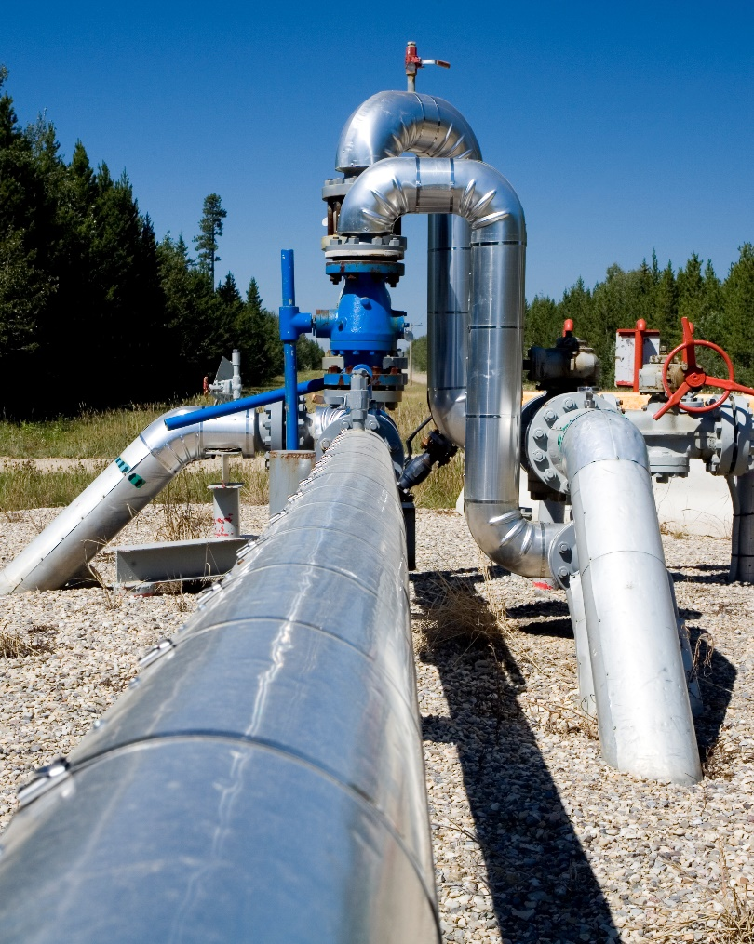
Fugitive Emissions - Sources
Most gas distribution emissions are ‘fugitive emissions.’ Fugitive emissions sources include:
Leak-prone pipe, especially cast iron and bare-steel systems, or plastic systems with known problems.
Commercial/industrial meter sets.
Compressor stations.
Residential meter sets.
Excavation damage and other incidents.

Slide 25
Links – EPA emissions data
GHG inventory vs GHG Reporting Program
EPA GHG Inventory and Sinks:
Draft 2021 GHG inventory and sinks
2021 GHG inventory and sinks methodology table
EPA GHG Reporting Program: Oil and Gas Industry
High Level: O&G Sector Industrial Profile
Facility Level: FLIGHT

Slide 26
Applicability to Section 114
Natural Gas Emissions
Gas Transmission
Underground Natural Gas Storage
Liquified Natural Gas
Natural Gas Distribution Companies & Master Meters
Gas Gathering & Boosting
Part 192/195 Pipeline Facilities for Commodities other than Natural Gas
But using natural gas as fuel, power, appurtenance or instrument gas
Leak-Prone Pipe
All Regulated Operators

Slide 27
Inspection Program Pilot Inspections Conducted in 3Q-2021
State refers to Operator’s main office location
State | GT | GD | MM | UNGS | LNG | GG | HL
IL |  | X |  | X | X
AK |  |  |  |  |  |  | X
TX |  |  |  | X
OH |  |  |  |  |  | X
UT | X
OH |  | X
FL |  |  | X
CT | X
TX |  |  |  |  |  |  | X
TX |  |  | X
TX |  |  |  |  |  | X
PA |  |  |  |  | X
TX | X
Operator’s program/procedures often applied to assets in multiple states

Slide 28
Inspection Program Pilot Inspection Conclusions
Many existing practices have been in place to minimize releases, prior to the enactment of Section 114.
Some Operators may already be obliged by EPA regulations to have emissions reduction programs in place
Voluntary industry methane reduction efforts are in place with some Operators
Many Operators collect leak information, but fewer routinely analyze that data to identify leak-prone pipe and take remedial/replacement actions or modify their processes
Identification of leak-prone pipe does not seem to be a recognized need by all operators

Slide 29
Inspection Program Initial Inspections
Programs & Procedures
Well-suited for Virtual Format
Mostly Stand-alone
Could be Bundled with other Inspections

Slide 30
Inspection Program Scope of Initial Inspections
Inspections will focus on verifying operator procedures contain written, detailed, technically supported measures for Emission Reduction and replacement/remediation of Leak-Prone Pipe
Inspections not focused on verifying compliance across the broad spectrum of PHMSA, State, and EPA regulations – but inspectors will not ignore violations discovered

Slide 31
Inspection Logistics
Illustrative Inspection Questions
To be posted on Web Site
Subject to change and adaptation for different operators, by different inspectors
Inspectors may ask follow up questions, soliciting the precise content and supporting technical basis for Operator procedures
One Inspection per Program
A single OPID may have multiple Programs
A single Program may cover multiple OPIDs
Inspection by PHMSA or State Partners

Slide 32
2022 Inspection Process EPA Programs & Regulations
Adoption or compliance with EPA programs and regulations may address some Section 114 requirements
Inspections not focused on compliance with EPA regulations or the universe of all PHMSA or State regulations -- but inspectors will not ignore violations discovered

Slide 33
Illustrative Inspection Questions Focus Areas
Natural Gas Emission Reduction
Vented Releases
Fugitive Releases
Leak-Prone Pipe
Remediation
Replacement

Slide 34
Inspection Program 2022 Inspection Topical Areas
Topic Areas | Questions
Scoping | 4
Compressors | 1
Drivers & Engines | 1
Leaks & Releases | 14
Leak Mitigation & Repair | 5
Regulator Stations | 2
Testing | 2
Flaring | 1
General | 2

Slide 35
Illustrative Inspection Questions Asset Group Table
Inspection | Asset Group | Topic Areas | Total Questions
Natural Gas Emissions | Gas Transmission | 7 | 14
 | Underground Natural Gas | 5 | 11
 | Liquified Natural Gas | 6 | 18
 | Distribution & Master Meters | 6 | 12
 | Gas Gathering & Boosting | 6 | 12
 | Non-Natural Gas Facilities | 4 | 5
Leak-Prone Pipe | All Operators | 2 | 4

Slide 36
Illustrative Inspection Questions Scoping
Inspection Coverage: What are your assets comprised of?
Gas Transportation: Do you transport natural gas as a specific commodity (i.e., not a byproduct or constituent of another substance)?
Driver or Engines: Do you use natural gas-fueled drivers or engines to compress natural gas?
Use of Natural Gas: Do you use natural gas for fuel or power appurtenances or instruments on regulated facilities?

Slide 37
Illustrative Inspection Questions Compressors
Do the maintenance and operations procedures for compressors include provisions to minimize fugitive natural gas losses?

Slide 38
Illustrative Inspection Questions Drivers & Engines
Do maintenance procedures include measures for monitoring and correcting incomplete combustion of natural gas in driver or engine exhausts and taking corrective action if identified?

Slide 39
Illustrative Inspection Questions Leaks & Releases
Identification of Fugitive Emissions: Do procedures provide a methodology for identifying sources of fugitive natural gas emissions in the system?
Venting: Do procedures identify measures for minimizing natural gas release volumes associated with non-emergency venting and blowdowns from operations and maintenance?
Investigation of unanticipated vented releases: Do procedures provide for investigation of any unanticipated vented releases of natural gas, and if so, what are the associated actions?

Slide 40
Illustrative Inspection Questions Leaks & Releases
Leak Data Collection and Analysis: Do procedures include a methodology to collect, retain and analyze detailed information from detected natural gas leaks, including those eliminated by lubrication, adjustment, tightening or otherwise below thresholds for regulatory reporting?
Leak Identification: Do procedures include instructions for personnel to detect leaks to help further reduce emissions in stations and along the right of way?

Slide 41
Illustrative Inspection Questions Leaks & Releases
Wellhead: Do procedures provide for periodic leakage surveys around the wellhead?
Annulus: Do procedures provide for periodic checking of wellhead annuluses for indication of leaks (e.g., unexplained pressure variations) ?
Field Integrity: Do procedures provide for leak surveys for well casing containment or geologic issues?
(These questions traditionally associated with UNGS)

Slide 42
Illustrative Inspection Questions Leaks & Releases
Tank Shell: Do procedures provide for monitoring for temperature variations on tank shells that could be indicative of leaks?
Tank Disturbances: Do procedures for tank inspections after meteorological or geophysical disturbances include leak detection?
Tank Cooldown: Do procedures provide that after cooldown stabilization is reached, flanges, valves and seals are checked for leaks?
Tank Boil off: Do procedures provide for collection of boil-off gas from LNG tanks to avoid releases?
(These questions traditionally associated with LNG Facilities)

Slide 43
Illustrative Inspection Questions Leak Mitigation & Repairs
Repair Procedures: Do procedures provide alternatives to cutouts (to reduce emissions)?
Do procedures define a process to identify, classify, mitigate and repair leaks?
Lost & Unaccounted for Gas: Do procedures provide for review of Lost & Unaccounted for Gas (LAUF)? Do procedures specify actions to reduce the associated volume?

Slide 44
Illustrative Inspection Questions Regulator Stations
Do Operator maintenance or operational procedures contain measures for reduction of natural gas releases from regulators?
Do Operator maintenance or operational procedures contain measures for identifying potential configuration changes that would reduce natural gas releases from regulators?

Slide 45
Illustrative Inspection Questions Testing
Emergency Shutdown Devices: Do procedures contain measures for ensuring ESD testing minimizes natural gas releases?
Relief Valves: Do relief valve testing procedures include measures to minimize natural gas releases?

Slide 46
Illustrative Inspection Questions Flaring
Do procedures for flaring from pipeline facilities for transporting natural gas include measures for minimization of natural gas emissions?
(Limited to Transportation Facilities)

Slide 47
Illustrative Inspection Questions General
Feedback to Design/Configuration Practices: Do operation and maintenance procedures contain mechanisms for identifying potential design/configuration changes for reducing natural gas releases?
Compressor Station: Do procedures contain mechanisms for minimizing natural gas emissions from operations and maintenance activities within a compressor station (i.e., beyond compressor/driver-specific procedures)?
What procedures are in place to reduce natural gas emissions during normal maintenance activities on facilities that contain LNG?

Slide 48
Illustrative Inspection Questions Leak-Prone: Leaks & Releases
What procedures are in place to monitor for and identify pipe segments that are leak prone?
What criteria (e.g., frequency of leak or failure events) are specified for determining a pipeline segment is leak-prone?

Slide 49
Illustrative Inspection Questions Leak-Prone: Leak Mitigation & Repairs
Example Section 114 Materials: Does the operator have procedures to identify cast iron, unprotected steel, wrought iron, and vintage plastic pipe, with known leak issues?
Other Materials: Do the procedures clearly define a process to address replacement or remediation of pipe segments with known leak issues beyond those specifically identified in Section 114?

Slide 50
Enforcement Process Citing the Act
If violations of Section 114 are discovered, PHMSA and State partners will take appropriate enforcement action citing the Act or the regulations, as appropriate.

Slide 51
Enforcement Options
Notice of Amendment – where an operator's plans or procedures are found to be inadequate
Notice of Probable Violation – where an operator has failed to comply with the applicable requirements
Other enforcement options, if appropriate, see 49 CFR part 190

Slide 52
Timeline of Significant Milestones
Publication of The PIPES Act, December-2020
Advisory Bulletin, June-2021
PHMSA builds Inspection Program in 2021
Operators compliant by late December-2021
Illustrative Inspection Questions on Web Site in January-2022
Program & Procedures Inspections starting in 2022
Implementation Inspections begin in 2023

Slide 53
Thank You!

Slide 54
For Further Information
As noted in the Federal Register Notice for this Webinar, Contact:
Byron Coy PE
Sr. Technical Advisor
byron.coy@dot.gov
609-771-7810

