Slide 1
Voluntary Information-Sharing System
Federal Advisory Committee
Subcommittee – Technology / R&D
Bryce Brown - Chairman
Report Out Presentation
August 23, 2018

Slide 2
Subcommittee - Technology and R&D, Members
Subcommittee Chair: Bryce Brown
Alternate Designated Federal Official: Chris McLaren
Subcommittee Members:
Eric Amundsen
Michael Bellamy
Bob Buchanan
Jason Cradit
Yiming Deng
Alicia Farag
Michael Keller
Holly Pearen
Chris Warner
Mark Zuniga
Invited Guests
Cliff Johnson, PRCI
Jason Skow, Integral Eng.

Slide 3
Subcommittee - Technology and R&D
Task Statement – Just to recap
Task Statement Number: 18-4
Task Statement Title: Support Committee by Recommending Secure System(s) Architecture. Make Recommendations required for Continuous Improvement and/or needed Development of Technologies and Methodologies
Task Statement Description(s):
Identify Assumptions from other Subcommittees for our inputs and outputs (Process Sharing & Best Practices) and define Taxonomy.
Determine/Define and standardize the applicable pipeline inspection information (quantitative) and its native data format (tabular, geospatial, etc.)
Conduct historical studies that help in the understanding of current best practices for; managing and sharing pipeline inspection information and the associated areas for continuous improvement.
Analyze/define data security and protection to safeguard the proprietary nature of the pipeline inspection information shared (quantitative).
Determine the Quality Control Procedures required to facilitate the accurate exchange of the pipeline inspection information.
Determine the feasibility of integrating the pipeline inspection information with other relevant pipeline safety data that is already available or envisioned to be developed. Are there data format, completeness, and/or platform issues that need to be addressed?
Determine the needed interpretation of the pipeline inspection information shared and the areas that could be addressed;
  understanding the capabilities/limitations, and best practices,
  data maintenance, continuous improvement, and/or further research and development, and
  perspective predictive analysis capabilities for threat and risk analysis purposes.

Slide 4
Subcommittee - Technology and R&D
Work Groups Established
Assumptions (understand the overlap/integration between Process Sharing and Best Practices Subcommittees in order to document the assumptions for the “Functional Specification(s)” and further define Taxonomy)
Architecture/IT (IT, user authorization, accessibility, security, database/software, etc.)
Continuous Improvement/R&D (considerations for improvements and/or developments)

Slide 5
Subcommittee - Technology and R&D
Review Subcommittee/Work Group #1 Accomplishments
Assumptions - Bryce Brown
  Evaluated overlap between other Subcommittees - Process Sharing and Best Practices
  Reviewed the Process Sharing draft Recommendations (12) and the Best Practices draft Recommendations (8)
  Worked on and Reviewed the developed discussion text (Jason Skow) and draft Recommendation areas provided prior to meeting, specifically in relation to ILI and API 1163 as Best Practice.

Slide 6
Work Group #1 - Proposed Recommendations
  The following draft recommendation areas are identified:
  Realize the proper utilization of API 1163 (share all Field Verification Measurements from ITD)
  Define standards for data delivery/validation
  Define inputs needed for meaningful analysis and comparison
  Define/Develop ITD Standards for pipe
    Technology
    Procedure (appropriate NDE technology application given the threat type and associated ILI System)
    Personnel (competency)
  Ensure potential outputs represent an “apples to apples” comparison

Slide 7
Subcommittee - Technology and R&D
Review Subcommittee/Work Group #2 Accomplishments
Architecture/I.T. - Jason Cradit & Mark Zuniga
  Reviewed the developed text and possible recommendations on proposed direction of Architecture/IT solutions for Voluntary Information Sharing System

Slide 8
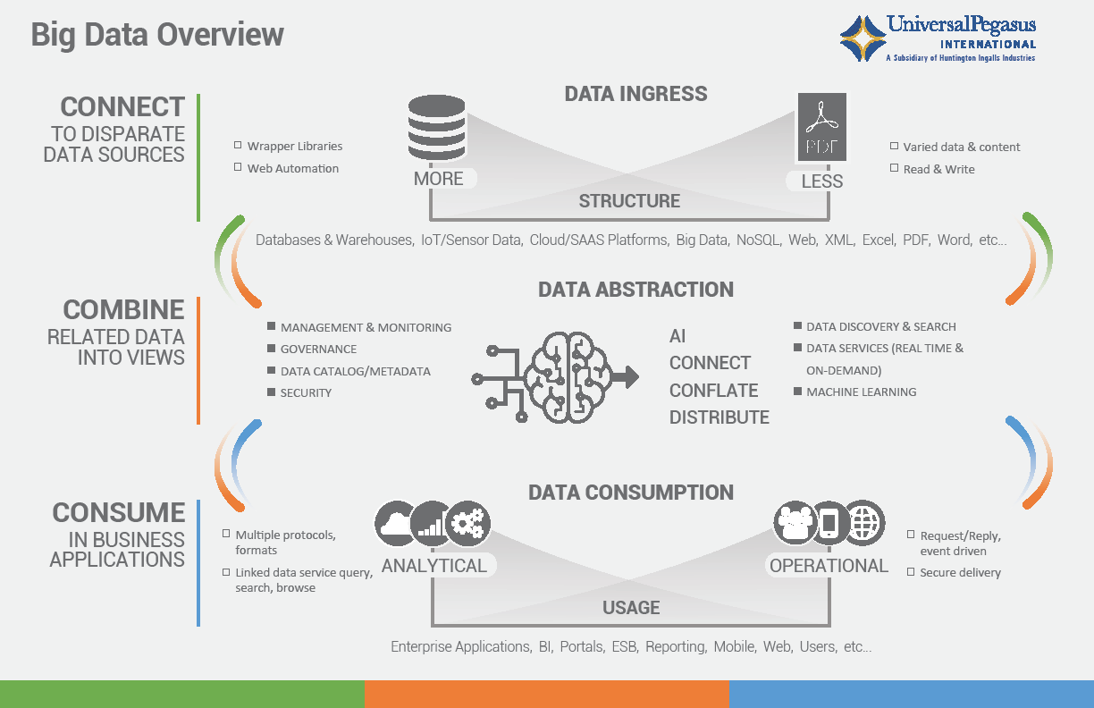
Work Group 2 - Technology and R&D Subcommittee

Slide 9
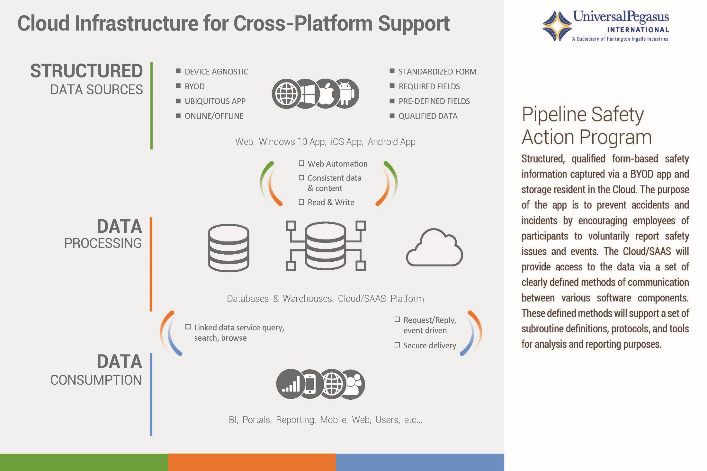
Work Group 2 - Technology and R&D Subcommittee

Slide 10
Subcommittee - Technology and R&D
Review Subcommittee/Work Group #3 Accomplishments
Continuous Improvement/R&D - Chris Warner & Michael Bellamy
  Reviewed the developed text and recommendations on needs for continuous improvement and R&D
  Documents reviewed included case studies for ILI, NDE, and ECDA
  Additional development discussed for Near Miss case study

Slide 11
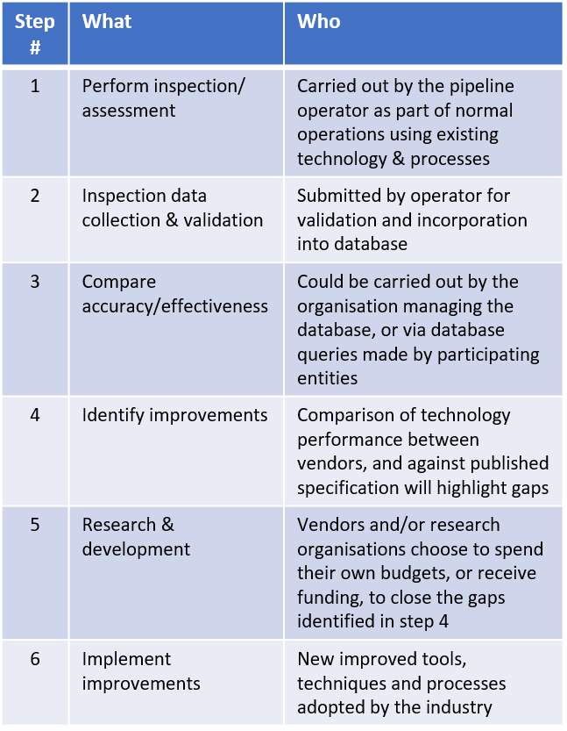
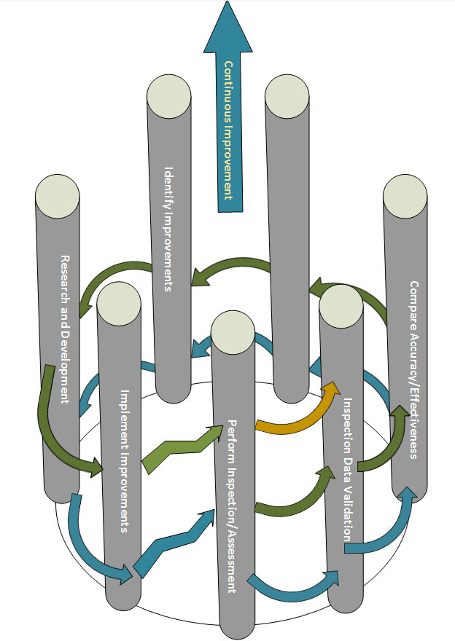
Work Group 3 - Technology and R&D Subcommittee
Virtuous Cycle for Continuous Improvement (example)

Slide 12
Work Group #3 - Proposed Recommendations
  From Chris Warner & Michael Bellamy’s draft documents, the following recommendation topic areas are identified:
  Continuous Improvement
  Transparency and sharing anonymous data
  Service provider and operators need to be able to see their performance individually and understand their performance against the total population

Slide 13
Path Forward
Working meetings (conference calls) on a bi-weekly basis to work on draft recommendations
September 20th is tentative date for next face-to-face meeting in Houston
  Draft text and recommendations to be approved by sub-committee members and submitted to Reporting sub-committee
Be ready for an October full committee “remote” meeting to look at final draft recommendations for voting

Slide 14
Questions/Comments

